Slide 1
Regression Project
Regression Project FM2 2024
Full Name | Email Address
Mfana Nkabinde | mfana.nkabinde@vodacom.co.za
Theo Tsinyane | theo.tsinyane@vodacom.co.za
Marcus Van Staden | marcus.vanstaden@vodacom.co.za
Manqoba Mnguni | manqoba.mnguni@vodacom.co.za
“All models are wrong, but some are useful” – George Box

Slide 2
Project Overview
Objective: Analyze and predict the impact of CO2 emissions from the agri-food sector on climate change.
Stakeholders: Policymakers, agricultural businesses, and environmental organizations.
Data Sources: Food and Agriculture Organization (FAO) and Intergovernmental Panel on Climate Change (IPCC).
Methods: Explore emission sources, perform regression analysis to predict temperature variations.
Outcome: Develop strategies for sustainable practices and provide actionable insights.

Slide 3

Dataset | Raw dataset key points
6965, 31
31 Features (30 Predictors + 1 Target Features).
6965 Records.
The data is collected from 236 different areas.
The data is collected from 1990 to 2020
There are 23 Carbon dioxide emission sources

Slide 4
Data Discovery
31 Features (30 Predictors + 1 Target Features).
6965 Records.
The data is collected from 236 different areas.
The data is collected from 1990 to 2020
There are 23 Carbon dioxide emission sources

Slide 5
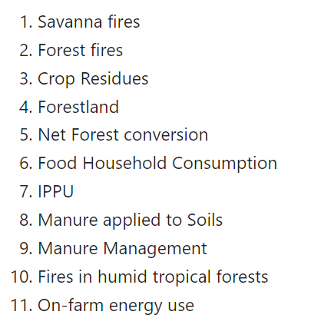
Data Cleaning
11 features had nulls values
4 methods were tested to fill the null values(filling with zeros, mean, median, or mode)
The method that resulted in minimum difference in average skewness was selected to fill the nulls in order not to cause biasness, i.e. mean imputation.
Features with NaN values

Slide 6
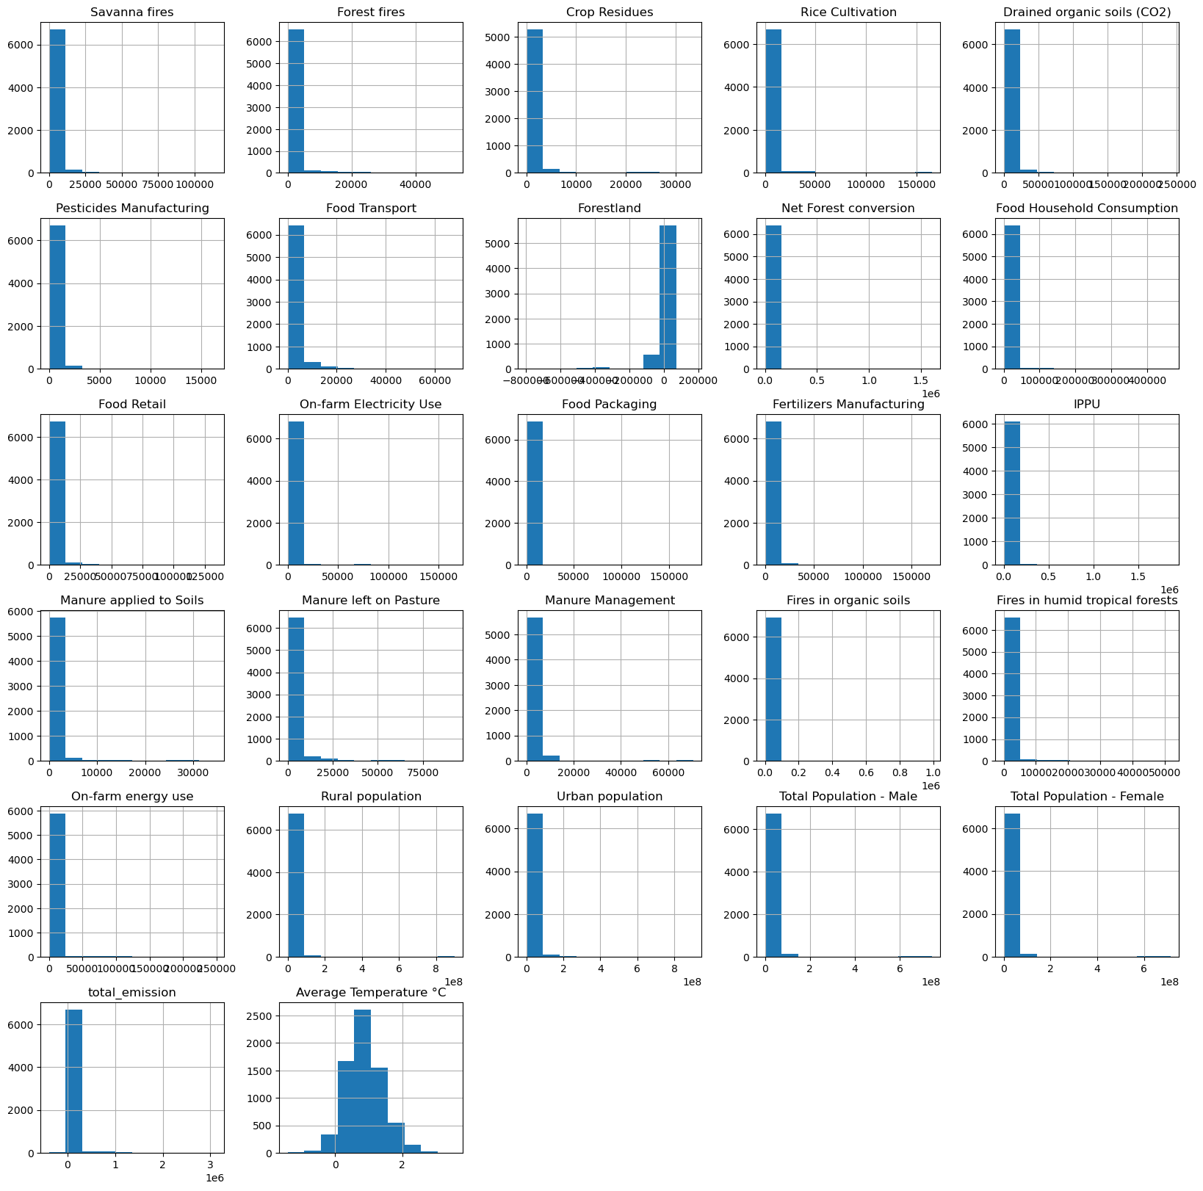
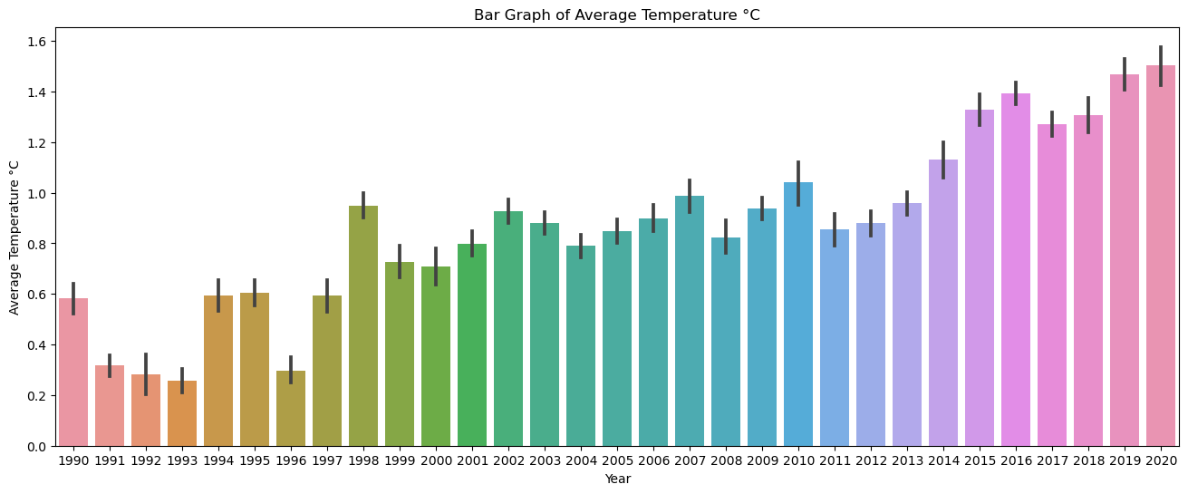
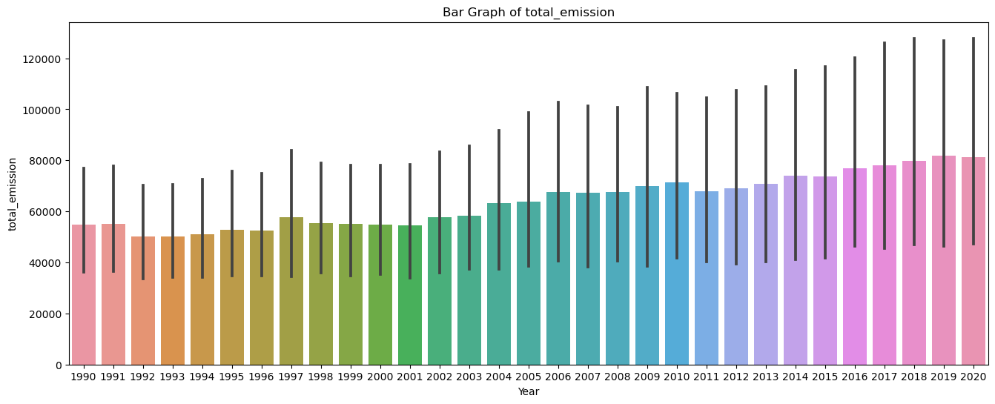
Exploratory Data Analysis

Slide 7
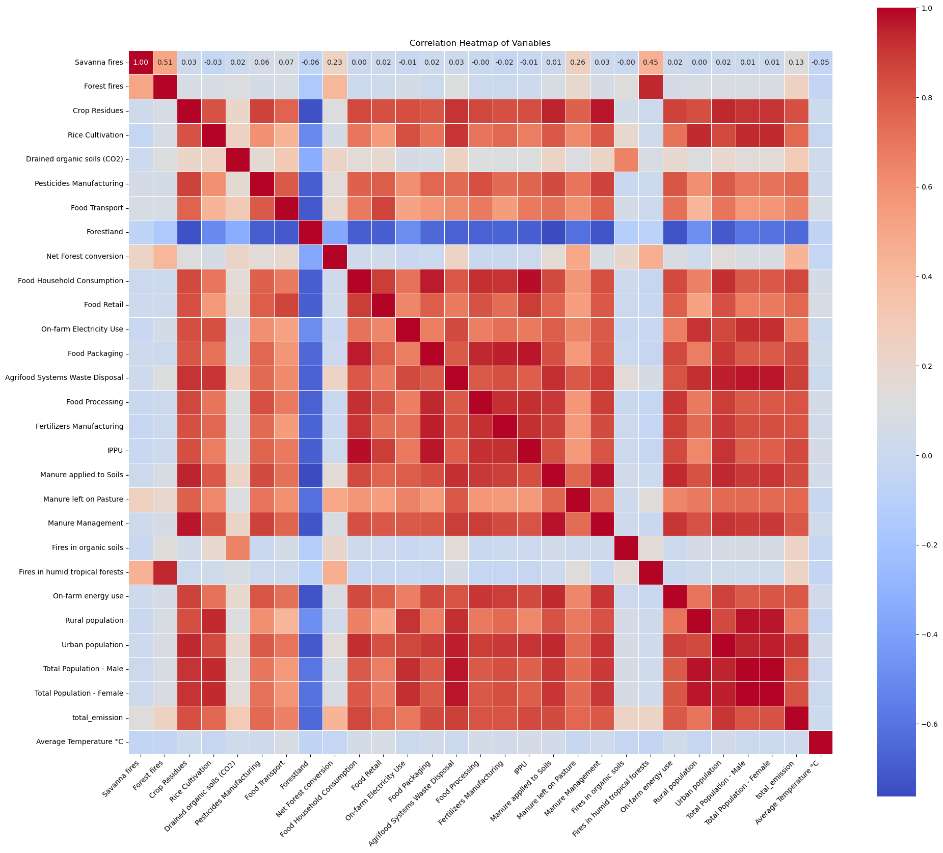
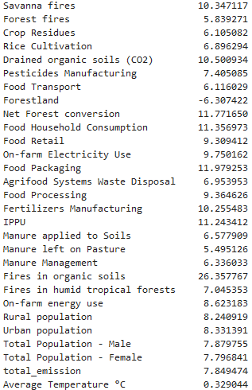
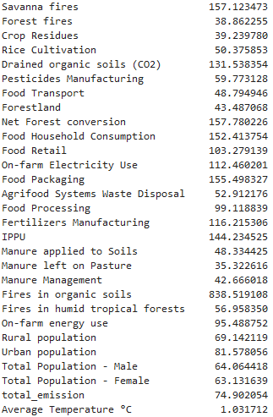
Skewness
Kurtosis

Slide 8
Variable Selection
The dataset contains one categorial feature, which is Area, thus dummy variable encoding is needed. However, our original 31 variable columns are now 266 given the dummy variable encoding, This is due to the dataset having 236 unique Areas as seen above.
To avoid model overfitting, the Area feature is dropped.
4 Variables show very low correlation towards our dependent variable Average Temperature °C; 1.On-farm Electricity Use, 2.Agrifood Systems Waste Disposal, 3.Total Population - Female, 4.Total Population - Male; We dropping these variables.
Sorted list of the p-values for each of the features show the significant p-value positive relationship, to avoid overfitting we going to focus on the features with the lowest p-values

Slide 9
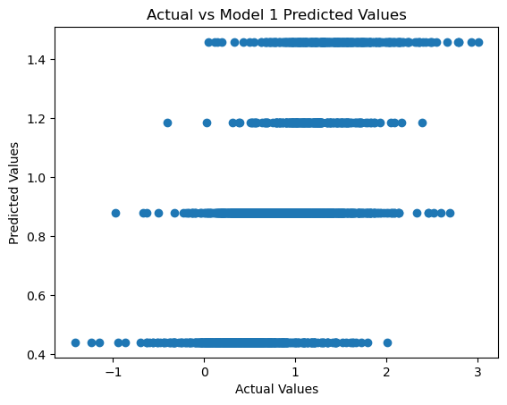
Model 1 | Decision Tree
The Root Mean Squared Error (RMSE) is 0.4474.
The R^2 Squared Error is 0.3300 The Model can predict Avg Temp with 0.4474 margin of Error
Thus, Model can be used by the Stakeholder for predictions

Slide 10
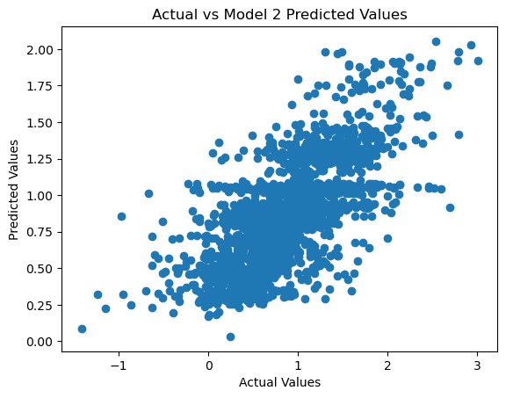
Model 2 | Random Forest
The Root Mean Squared Error (RMSE) is 0,4022.
The R^2 Squared Error is 0.4634
The Model can predict Avg Temp with margin of Error
Thus, Model can be used by the Stakeholder for predictions

Slide 11
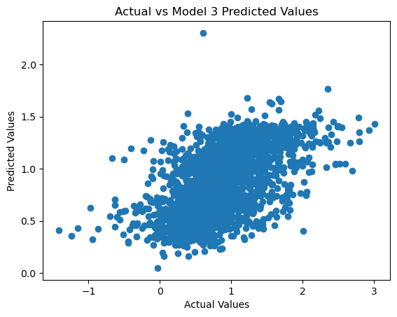
Model 3 | Simple Linear Regression
The Root Mean Squared Error (RMSE) is 0,4503.
The R^2 Squared Error is 0,3275
The Model can predict avg Temp with 0,45 degrees margin of Error
Thus, Model can be used by the Stakeholder for predictions.

Slide 12
Model Selection
Model | RMSE | R^2 | Comment
Model 1 – Decision Tree | 0.4474 | 0.3300
Model 2 – Random Forest | 0.4022 | 0.4634 | Highest R^2 and the lowest RMSE
Model 3 - Simple Linear Model | 0,4503 | 0,3275 | Highest RMSE and the lowest R^2
The Random Forest is selected as it has the lowest RMSE, which suggests it makes the least prediction error on average. Also, it has the highest Coefficient of Determination (R^2) with indicates that the proportion of the variance in the target variable that is predictable from the features.
Recommendations – Using Random Forest for Average Temperature predictions is more appropriate since it balances between model accuracy and robustness, handling nonlinear relationships and interactions better than a simple decision tree or linear model.

